Slide 1
Pre-Calc & Trig
Day 46

Slide 2
Bell Work
When x = 3 and y = 5, by how much does the value of 3x² – 2y
exceed the value of 2x² – 3y ?
3
14
17
20
51

Slide 3
From Last Time
Day 1: Pg 394 #5-7, 11-19 (odd)
Day 2: Pg 394 #9, 27-30, 33-34, 49
Day 3: Pg 394 #21, 39-42, 63, 75

Slide 4
5.3 Solving Trig Equations
Objective: To solve equations involving trigonometry using algebraic techniques such as combining like terms, and factoring to isolate the trig function.

Slide 5
Solve: sin x = 1 - sin x Hint: Combine like terms

Slide 6

Solve: 2 sin x = 1
$$2 sin⁡x = 1$$
$$sin⁡x = ½$$
$x=\frac{π}{6}$ $x=\frac{5π}{6}$
$x=\frac{π}{6}+2nπ$ $x=\frac{5π}{6}+2nπ$

Slide 7

Solve: $2sin^{2}x−\sin{x}−1=0$ Hint: Factor

Slide 8


Solve: $2sin^{2}x−\sin{x}−1=0$ Hint: Factor
$$(2\sin{x+1)(\sin{x−1)=0}}$$
$$(2\sin{x+1)=0 (\sin{x−1)=0}}$$
sin x = -1/2 sin x = 1
$x=\frac{7π}{6},\frac{11π}{6}$ $x=\frac{π}{2}$
$$π$$

Slide 9

$$Solve {\cot{x}cos}^{2}x=2\cot{x}$$ Factor

Slide 10
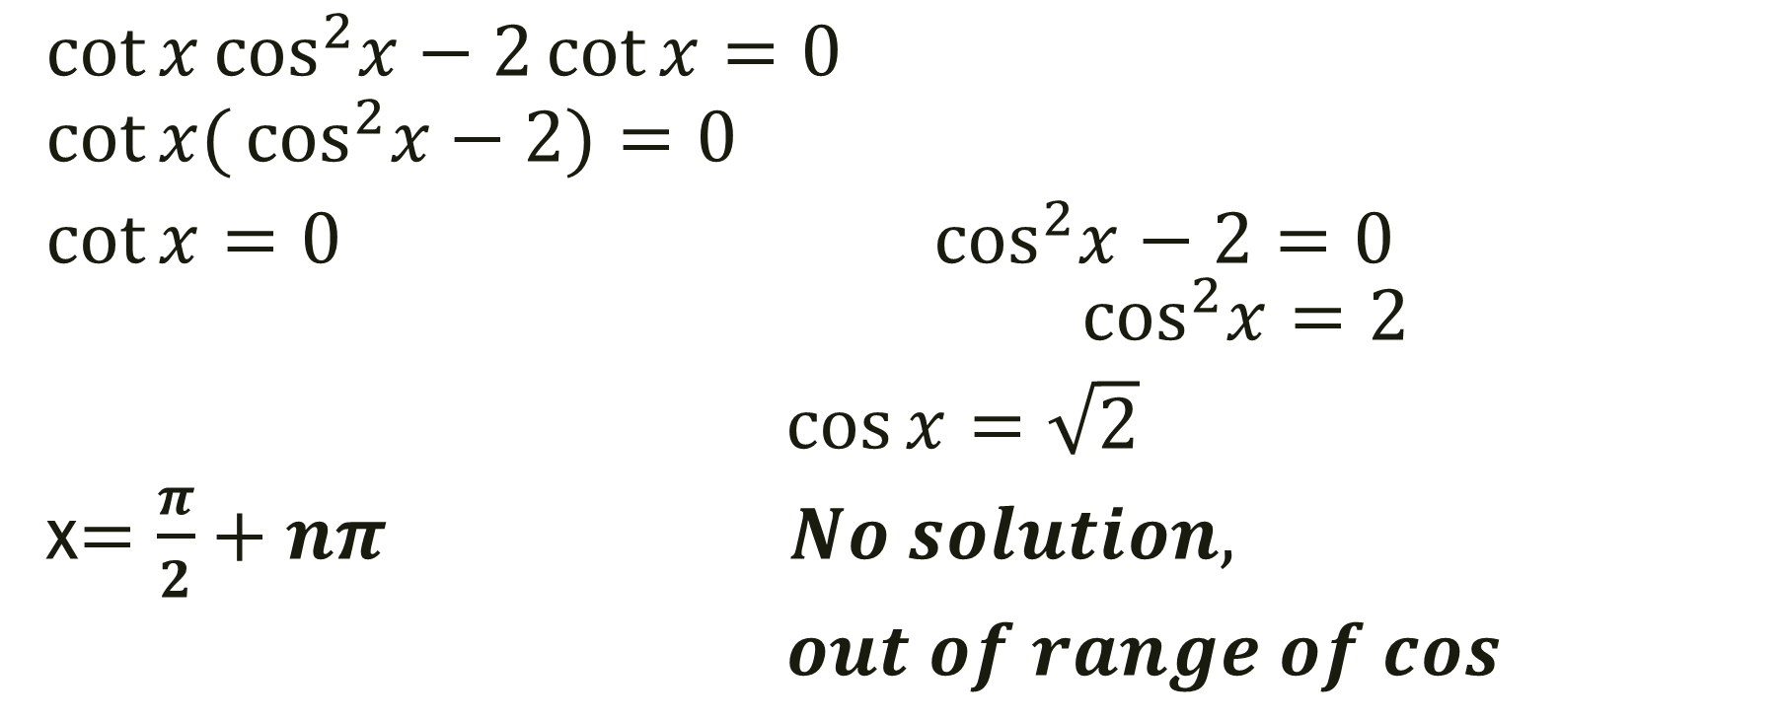
$$Solve {\cot{x}cos}^{2}x=2\cot{x}$$ Factor
$${\cot{x}cos}^{2}x−2\cot{x}=0 \\ {\cot{x(}cos}^{2}x−2)=0$$
$\cot{x=0}$ $\cos^{2}x−2=0$ $\cos^{2}x=2$
$\cos{x}=\sqrt{2}$
x$=\frac{π}{2}+nπ No solution,$
$out of range of cos$

Slide 11
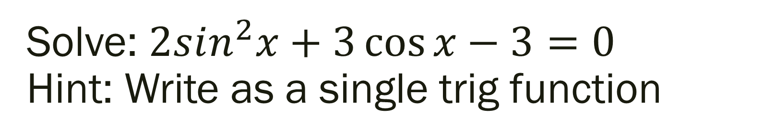
Solve: $2sin^{2}x+3\cos{x}−3=0$ Hint: Write as a single trig function

Slide 12
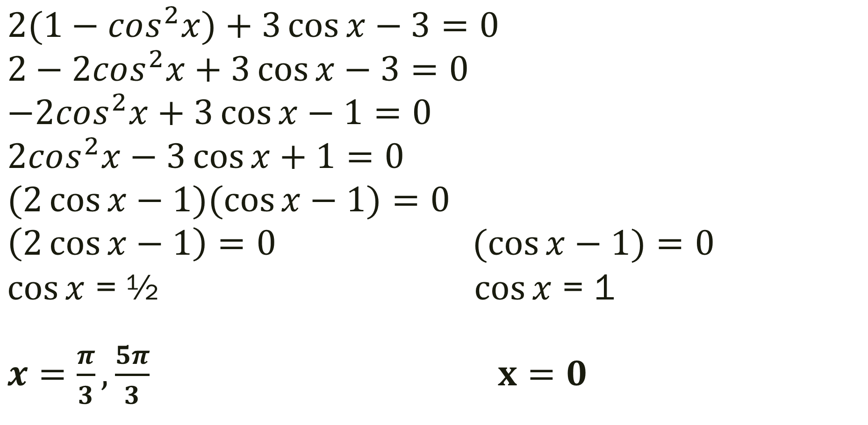

Solve: $2sin^{2}x+3\cos{x}−3=0$ Hint: Write as a single trig function
$$2(1−cos^{2}x)+3\cos{x}−3=0$$
$$2−2cos^{2}x+3\cos{x}−3=0$$
$$−2cos^{2}x+3\cos{x}−1=0$$
$$2cos^{2}x−3\cos{x}+1=0$$
$$(2\cos{x}−1)(\cos{x−1)}=0$$
$$\left(2\cos{x}−1\right)=0 (\cos{x−1)}=0$$
$\cos{x}$ = ½ $\cos{x}$ = 1
$x=\frac{π}{3},\frac{5π}{3}$ $x=0$

Slide 13
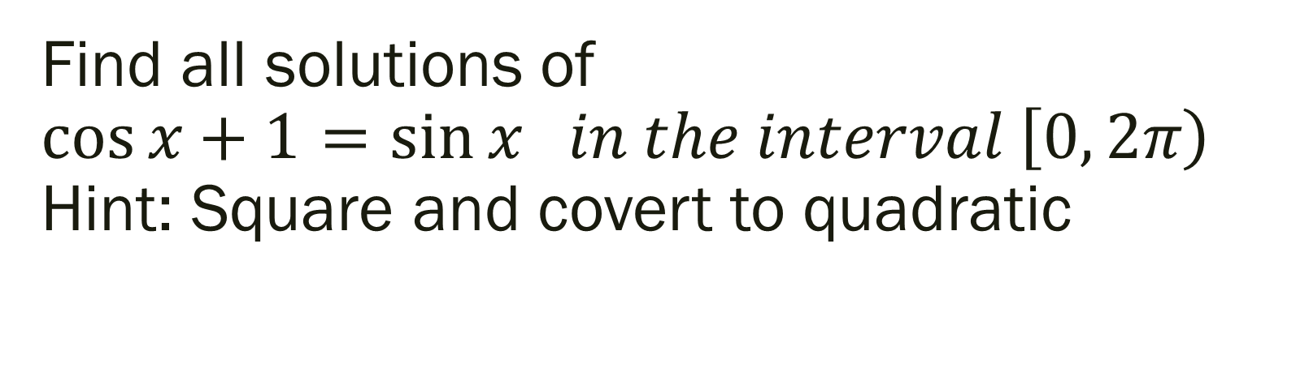
Find all solutions of $\cos{x+1=\sin{x in the interval \left[0, 2π\right)}}$ Hint: Square and covert to quadratic

Slide 14
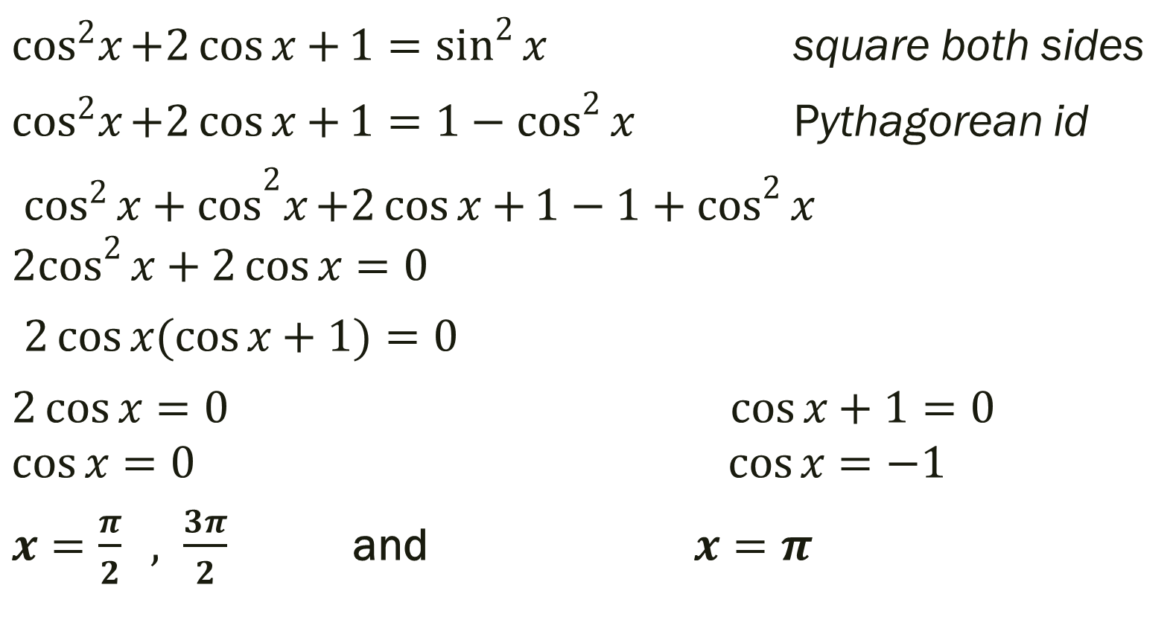
$$\cos{x+1=\sin{x in the interval \left[0, 2π\right)}}$$
$\cos^{2}x{+2\cos{x+}1=\sin^{2}{x}}$ square both sides
$\cos^{2}x{+2\cos{x+}1={1−cos}^{2}{x}}$ Pythagorean id
${\cos^{2}{x}+cos}^{2}x{+2\cos{x+}1−{1+cos}^{2}{x}}$
$${2cos}^{2}{x}+2\cos{x}=0$$
$2\cos{x(\cos{x+1)=0}}$
$2\cos{x=0 \cos{x+1=0}}$
$$\cos{x=0 \cos{x=−1}}$$
$x=\frac{π}{2} , \frac{3π}{2}$ and $x=π$
But…..

Slide 15
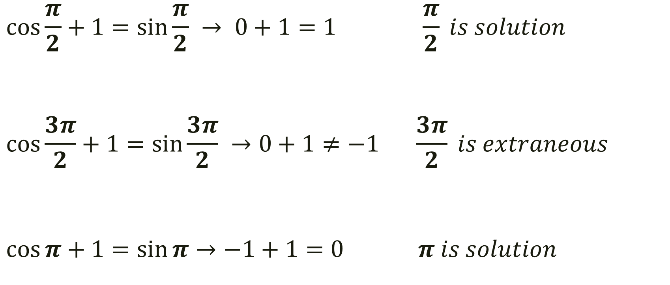
But… since you squared in the beginning you need to check for extraneous solutions…
$$\cos{\frac{π}{2}+1=\sin{\frac{π}{2} }}→ 0+1=1 \frac{π}{2} is solution$$
$$\cos{\frac{3π}{2}+1=\sin{\frac{3π}{2} }}→0+1≠−1 \frac{3π}{2} is extraneous$$
$\cos{π+1=\sin{π}}→−1+1=0$ $π is solution$

Slide 16

$$Solve 2\cos{3x}−1=0$$ Hint: Multiple angles

Slide 17

$$Solve 2\cos{3x}−1=0$$ Hint: Multiple angles
$$2\cos{3x}=1$$
$$\cos{3x}=1/2$$
$3x=\frac{π}{3}+2nπ 3x=\frac{5π}{3}+2nπ$
$$x=\frac{π}{9}+\frac{2nπ}{9} x=\frac{5π}{9}+\frac{2nπ}{9}$$

Slide 18

$$Solve \sec^{2}x−2\tan{x=4}$$

Slide 19
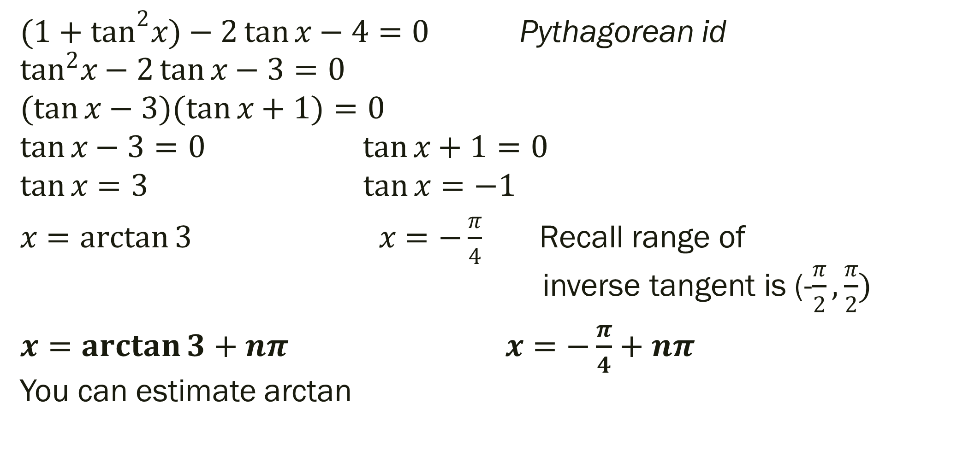

$$Solve \sec^{2}x−2\tan{x=4}$$
${(1+tan}^{2}x)−2\tan{x−4=0}$ Pythagorean id $$\tan^{2}x−2\tan{x−3=0}$$
$$(\tan{x}−3)(\tan{x+1)=0}$$
$$\tan{x−3}=0 \tan{x+1=0}$$
$$\tan{x=3} \tan{x=−1}$$
$x=\arctan{3} x=−\frac{π}{4}$ Recall range of inverse tangent is (-$\frac{π}{2}, \frac{π}{2})$
$x=\arctan{3}+nπ x=−\frac{π}{4}+nπ$ You can estimate arctan

Slide 20
5.4 Sum and Difference Formulas
Objective: Use sum and difference formulas to evaluate trig functions, verify identities, and solve trig equations

Slide 21
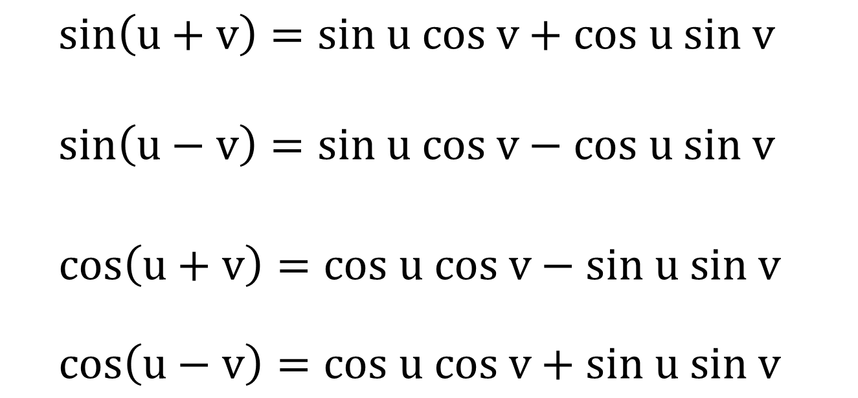
Sum and Difference Formulas [page 398]
$sin\left(u+v\right)=sin u cos v+cos u sin v$ $$sin\left(u−v\right)=sin u cos v−cos u sin v$$ $$cos\left(u+v\right)=cos u cos v−sin u sin v$$
$$cos\left(u−v\right)=cos u cos v+sin u sin v$$

Slide 22
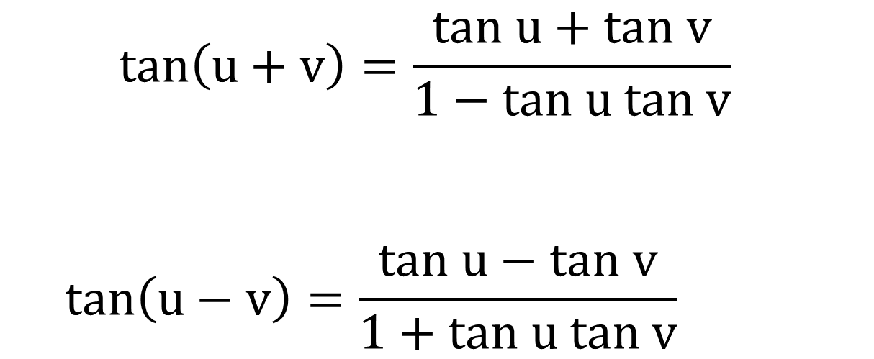
Sum and Difference Formulas [page 398]
$$tan\left(u+v\right)=\frac{tan u+tan v}{1−tan u tan v}$$
$$tan\left(u−v\right)=\frac{tan u−tan v}{1+tan u tan v}$$

Slide 23

Example 1 (Evaluate a Trig Function)
Find the exact value of $\sin{\frac{π}{12}}$

Slide 24
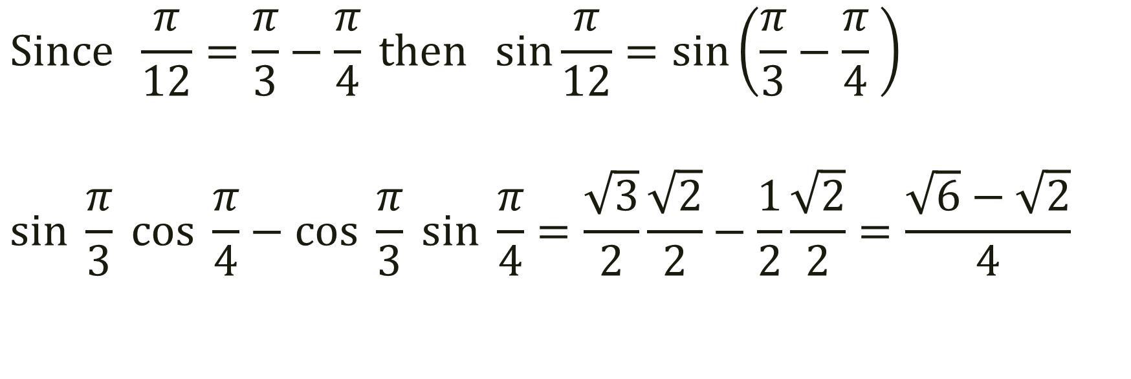

Find the exact value of $\sin{\frac{π}{12}}$
$$Since \frac{π}{12}=\frac{π}{3}−\frac{π}{4} then \sin{\frac{π}{12}}=\sin\left(\frac{π}{3}−\frac{π}{4} \right)$$
$$sin \frac{π}{3} cos \frac{π}{4}−cos \frac{π}{3} sin \frac{π}{4}=\frac{\sqrt{3}}{2}\frac{\sqrt{2}}{2}−\frac{1}{2}\frac{\sqrt{2}}{2}=\frac{\sqrt{6}−\sqrt{2}}{4}$$

Slide 25

Example 2 (Evaluate a Trig Function)
Find the exact value of $\cos{15°}$

Slide 26
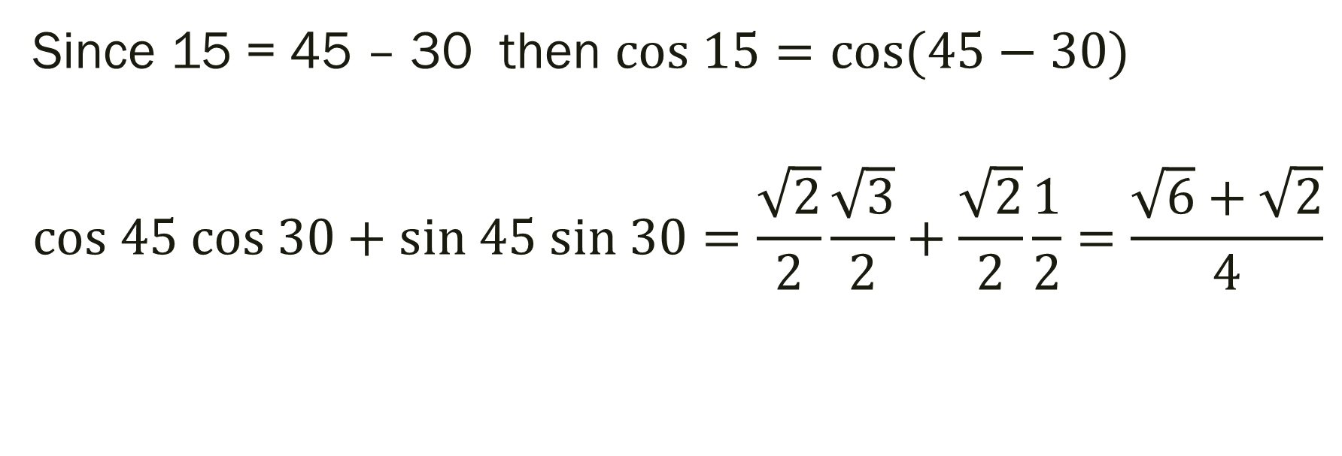

Find the exact value of $\cos{15°}$
Since 15 = 45 – 30 then $cos 15=cos{(45−30)}$
$$cos 45 cos 30+sin 45 sin 30=\frac{\sqrt{2}}{2}\frac{\sqrt{3}}{2}+\frac{\sqrt{2}}{2}\frac{1}{2}=\frac{\sqrt{6}+\sqrt{2}}{4}$$

Slide 27

Example 3 (Simplify the Expression)
Simplify: $\sin{(θ−\frac{π}{2})}$

Slide 28
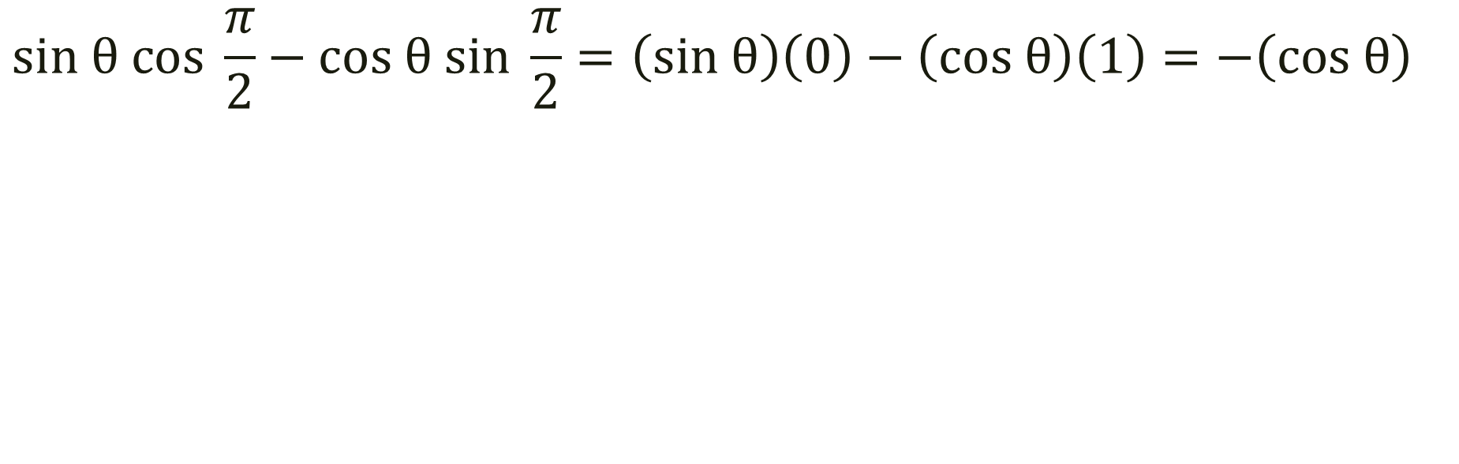

Simplify: $\sin{(θ−\frac{π}{2})}$
$$sin θ cos \frac{π}{2}−cos θ sin \frac{π}{2}=\left(sin θ\right)\left(0\right)−\left(cos θ\right)\left(1\right)=−\left(cos θ\right)$$

Slide 29
For Next Time
Pg 402 #7-13 (odd), 37-40

